Slide 1
James Brown's "It's A Man's Man's Man's world"
By Isaiah, Eli, Dawson

Slide 2
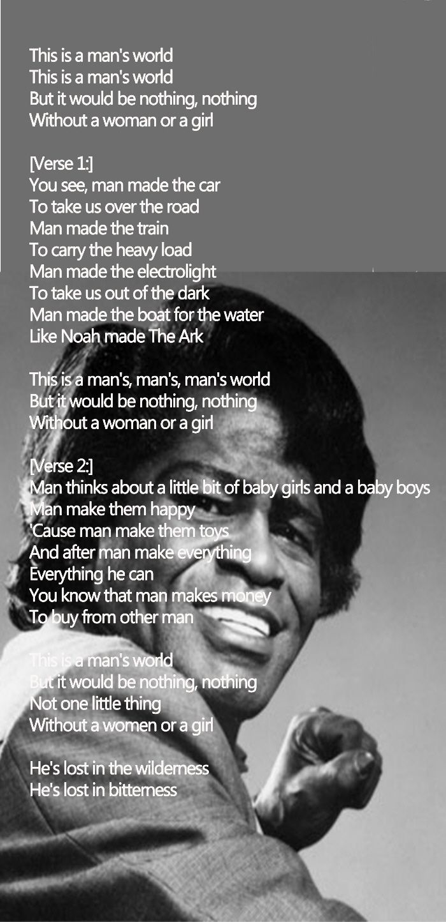
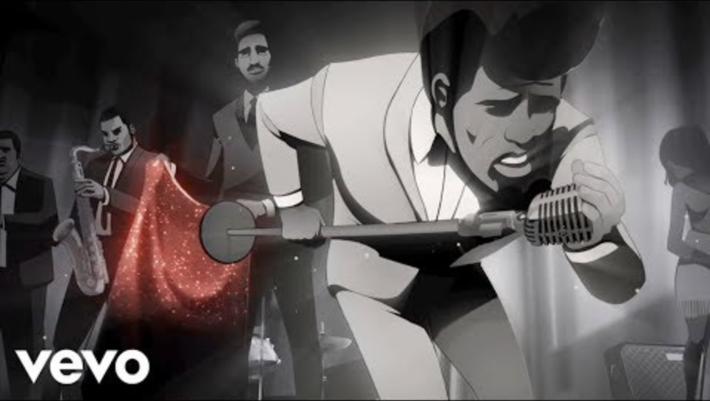
Lyrics, and video
James Brown - It's A Man's Man's Man's World

Slide 3
Rhetorical Situation
James Brown’s “It’s a Man’s Man’s Man’s World” effectively uses rhetorical situation to argue that while men and women can live independently, true fulfillment comes when they come together.

Slide 4
Rhetorical Situation
Text:
Soul Music
Having the song be slower lets his audience think about the lyrics more deeply
Author:
The artist is James Brown, who started as a gospel singer and then would become known as the God Father of soul music.
His genre is best identified is soul/RNB
Audience:
Soul Music fans are usually more open-minded and reflective inward to themselves

Slide 5
Rhetorical Situation
Purpose:
James Brown want to make his audience aware of the fact a world without women would be a world without a purpose, nothing
Man create for women and women give purpose to those creations
Kairos:
Brown shows all the achievements of man, but not women, showing that women are too often overlooked and should be see as equally to men
“You see, man made the cars to take us over the road Man made the train to carry the heavy load Man made electric light to take us out of the dark Man made the boat for the water, like Noah made the ark.
Women, when Brown wrote the song, were still look as lesser than man and Brown wanted argue against that belief

Slide 6
Logos
-In “It’s a Man’s Man’s Man’s World” by James Brown, he claims that the achievements men and humankind can complete in this world are only possible with women too.

Slide 7
Logos
Claim:
While men created this world, women gave the creations purpose and meaning
"This is a man's world, this is a man's world But it wouldn't be nothing, nothing without a woman or a girl."
“Man thinks about our little bitty baby girls And our baby boys Man make them happy 'Cause man make them toy
Shows that man’s creations require a reason to be made, and women give man that reason

Slide 8
Ethos
James Brown’s “It’s a Man’s Man’s Man’s World” employs ethos by referencing human history to illustrate that while men may build, their achievements are meaningless without women."

Slide 9
Ethos
Authority:
James Brown has inherent authority by being a successful artist/singer, which made his voice a powerful tool to use for protesting
Shows moral authority by saying, both men and women have their roles in life, both need each other
He used the authority for the history of mankind, to show the roles for men and women, men create, women bring life/purpose/reason

Slide 10
Ethos
Common Ground:
“But it wouldn't be nothing, nothing, not one little thing, without a woman or a girl”
Humbles himself, no matter how much work we/he does, it is worthless without women
“Man thinks about our little bitty baby girls and our baby boys Man made them happy, 'cause man made them toys”
James relates to men who create for those around him, wants to make life better for his family/friends

Slide 11
Ethos
Goodwill:
“He's lost in the wilderness He's lost in bitterness, he's lost lost”
Warning for those who are against women rights, think they are above women
Life will have no purpose, because they will live without women
“This is a man's world, this is a man's world, But it wouldn't be nothing, nothing without a woman or a girl”
World may be created by men, but it is pointless without women there

Slide 12
Pathos
James Brown’s “It’s a Man’s Man’s Man’s World” appeals to pathos by evoking a sense of loneliness and vulnerability, emphasizing the emotional weight of his lyrics."

Slide 13
Pathos
Word Choice:
Using the word “nothing” shows that nothing can replace women and the joy they bring to men. Without women men would be lonely
“Lost”, women keep men in one place, meaning without women, men would kept building and building, but it will never fill their longing for love/ joy
Vivid:
“Man thinks about our little bitty baby girls and our baby boys Man made them happy, 'cause man made them toys”, shows that men are vulnerable around those he loves, man will stop building elaborate creations and make simple toys to make other happy

Slide 14
Pathos
Sensory:
“Lost” gives the audience the sense of sight, shows that men are blind (to life) without women their to guide them
Scare Tactic:
“But it wouldn't be nothing, nothing, not one little thing, without a woman or a girl He's lost in the wilderness He's lost in bitterness, he's lost lost”, Brown is scaring his audience by portraying a man as lost without a woman, he suggests a sense of dependence and fear, suggesting that those who undervalue women should recognize their importance and the consequences of their absence.

Slide 15
Conclusion
James Brown’s “It’s a Man’s Man’s World” effectively used rhetorical situation, logos, ethos, and pathos to highlight the unique purpose men and women have with each other.

Slide 16
Conclusion
Rhetorical Situation:
James Brown is trying to argue that man and women require a coexistence with each other
Men can build to make the world safer and better, but there is no point without women to bring purpose into the world
Jame Brown wrote this song to argue for women rights, men and women should live equally, equality

Slide 17
Conclusion
Logos:
James Brown main claim in his song is that men and women require coexistence, men create, and women bring purpose for those creations
“This is a man's world, this is a man's world But it wouldn't be nothing, nothing without a woman or a girl.”
He tries to claim his argument with:
“Man thinks about our little bitty baby girls And our baby boys Man make them happy 'Cause man make them toys
Men create to help others, man would have to reason to create if women were not around, women give men the reason to build

Slide 18
Conclusion
Ethos:
Uses his position as a popular singer to argue that men require women and women require men
Humbles himself and all men, men are useless, nothing, without women with them
Relates to men who work to benefit those he loves
Men create/work to support his family
Warns men who think women are useless, will be lost, no purpose

Slide 19
Conclusion
Pathos:
The word “nothing” means that women are irreplaceable, and man’s creations are worthless without women
Men build to better the lives of those around him
Men are “lost” without women in the world, no reason to create, no purpose
Men are dependent on women, and those who disagree will live a depressing life

